Slide 1
LANDSCAPE NARRATIVES
Welcome!
Facilitators:
Add names of facilitators and dates
LOGOS:
Add relevant logos
Patricia Bon, Max Levy, and Bemmy Granados. EcoAgriculture Partners
January 29, 2024

Slide 2
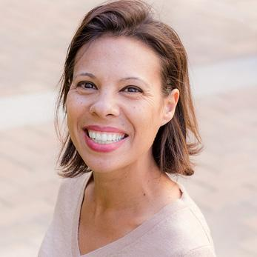
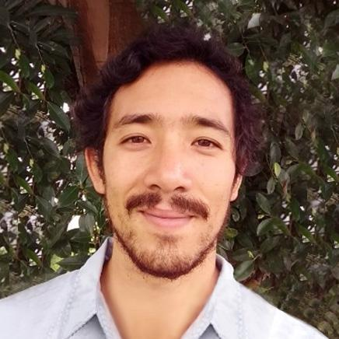
WELCOME
Meet the team
Replace with name of your organization
Replace photos and names of facilitators
Bemmy Granados
Patricia Bon, Project Manager
Max Yamauchi
Replace with your logos
Notes:
[Introduce the facilitation team]
[Post links to bios in chat box]
[Encourage the group to present themselves in the chat, putting their names, organization and where they are coming from]

Slide 3
OBJECTIVES
Understand what Landscape Narratives are.
Understand why Landscape Narratives are important for our landscape. And how they can help us.
Identify the communication needs of different stakeholders.
Select appropriate formats and media for our landscape narratives.
Plan for co-creating a landscape narrative that serves the needs of landscape stakeholders.

Slide 4
PROGRAM
Welcome and introductions
What are Landscape Narratives? Why are they important?
BREAK
Visualizing a story
LUNCH BREAK
Right format for the right audience
Making Landscape Narratives work
BREAK
Reflection and feedback

Slide 5
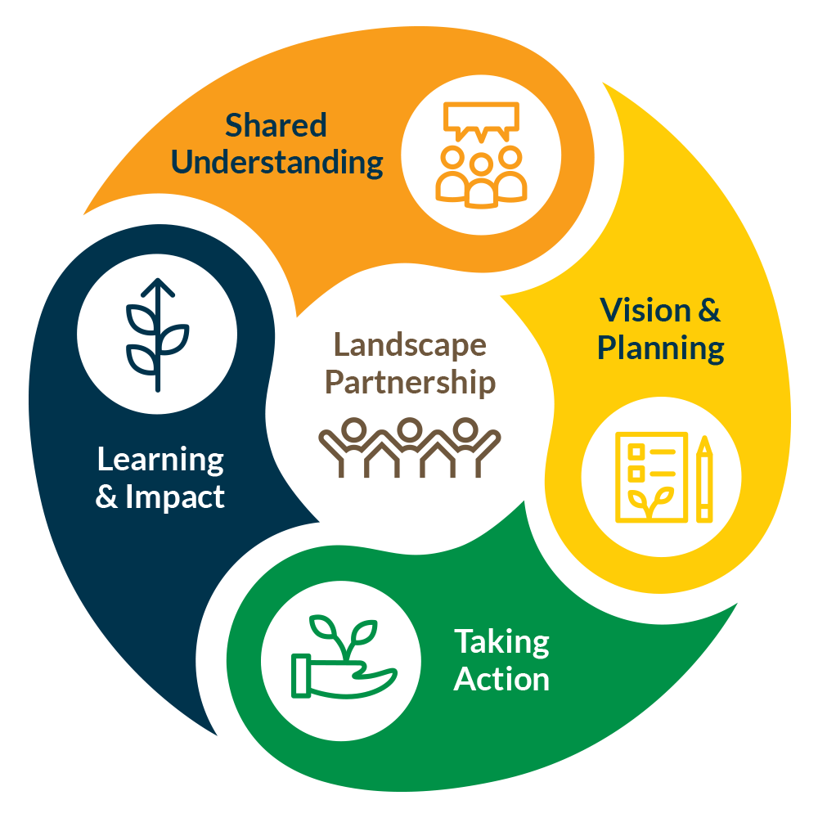
5 ELEMENTS OF ILM
Landscape Partnership
Shared Understanding
Vision & Planning
Taking Action
Learning & Impact

Slide 6
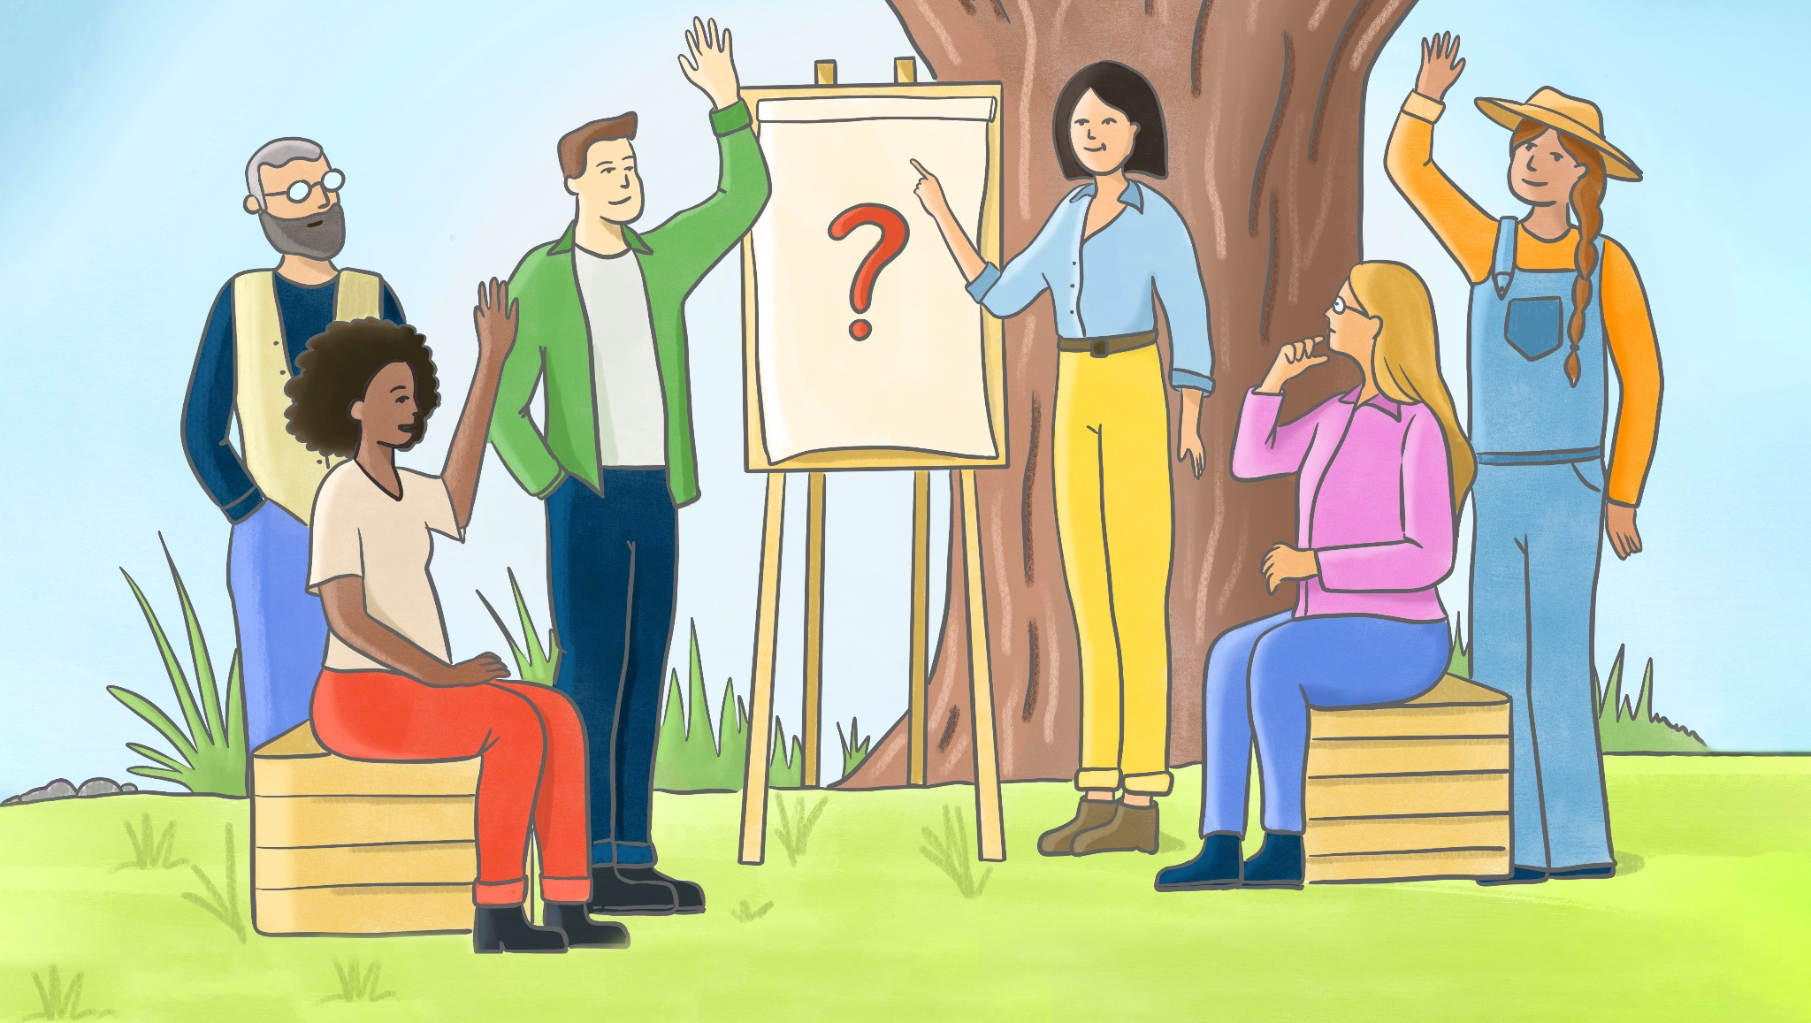
Q & A

Slide 7
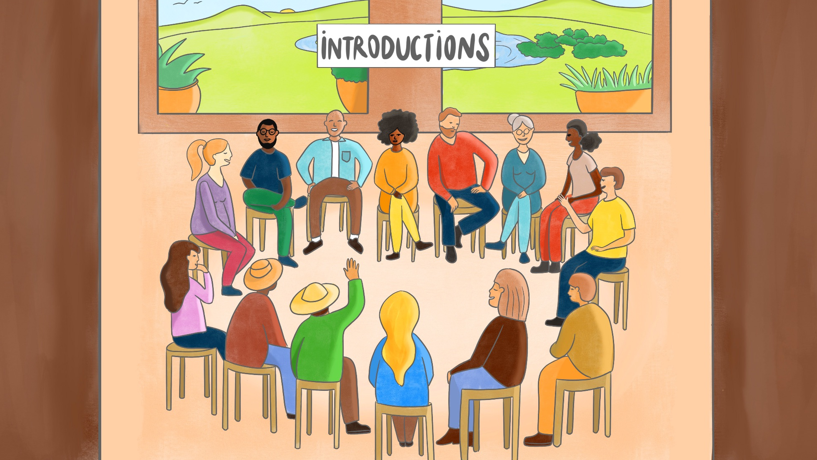

Slide 8
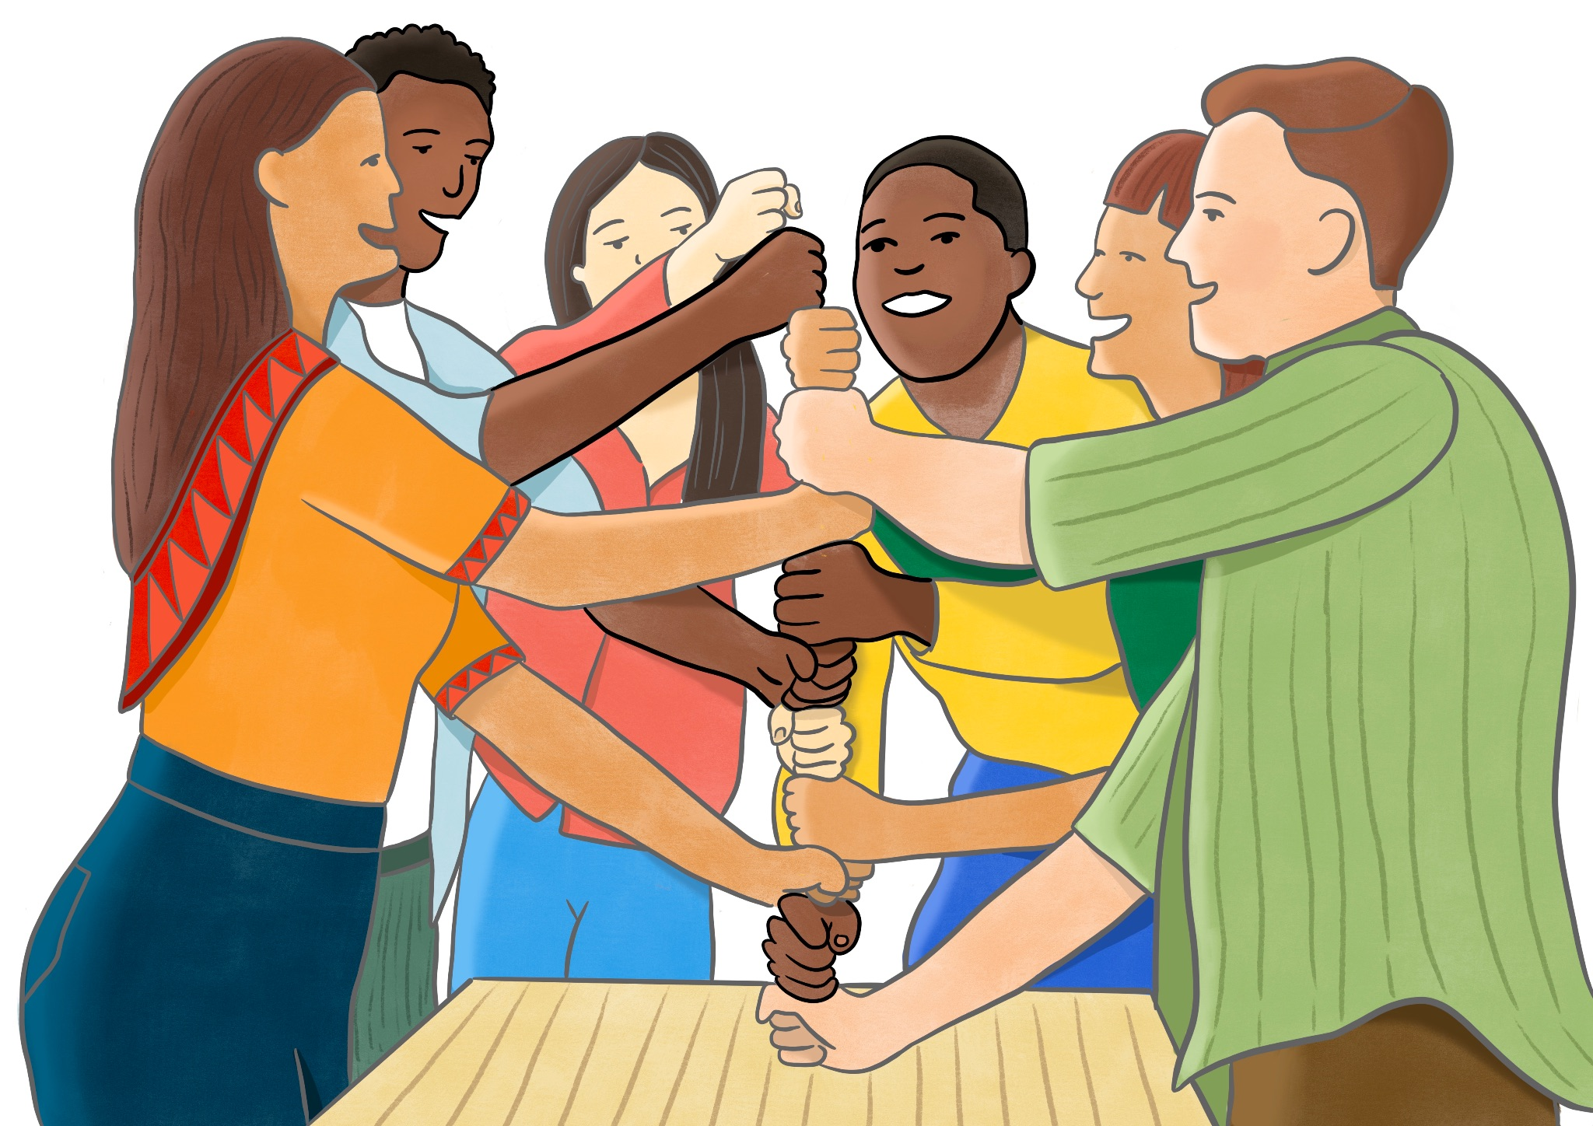
ENERGIZER
X MIN
X MIN

Slide 9
WHAT ARE LANDSCAPE NARRATIVES?

Slide 10
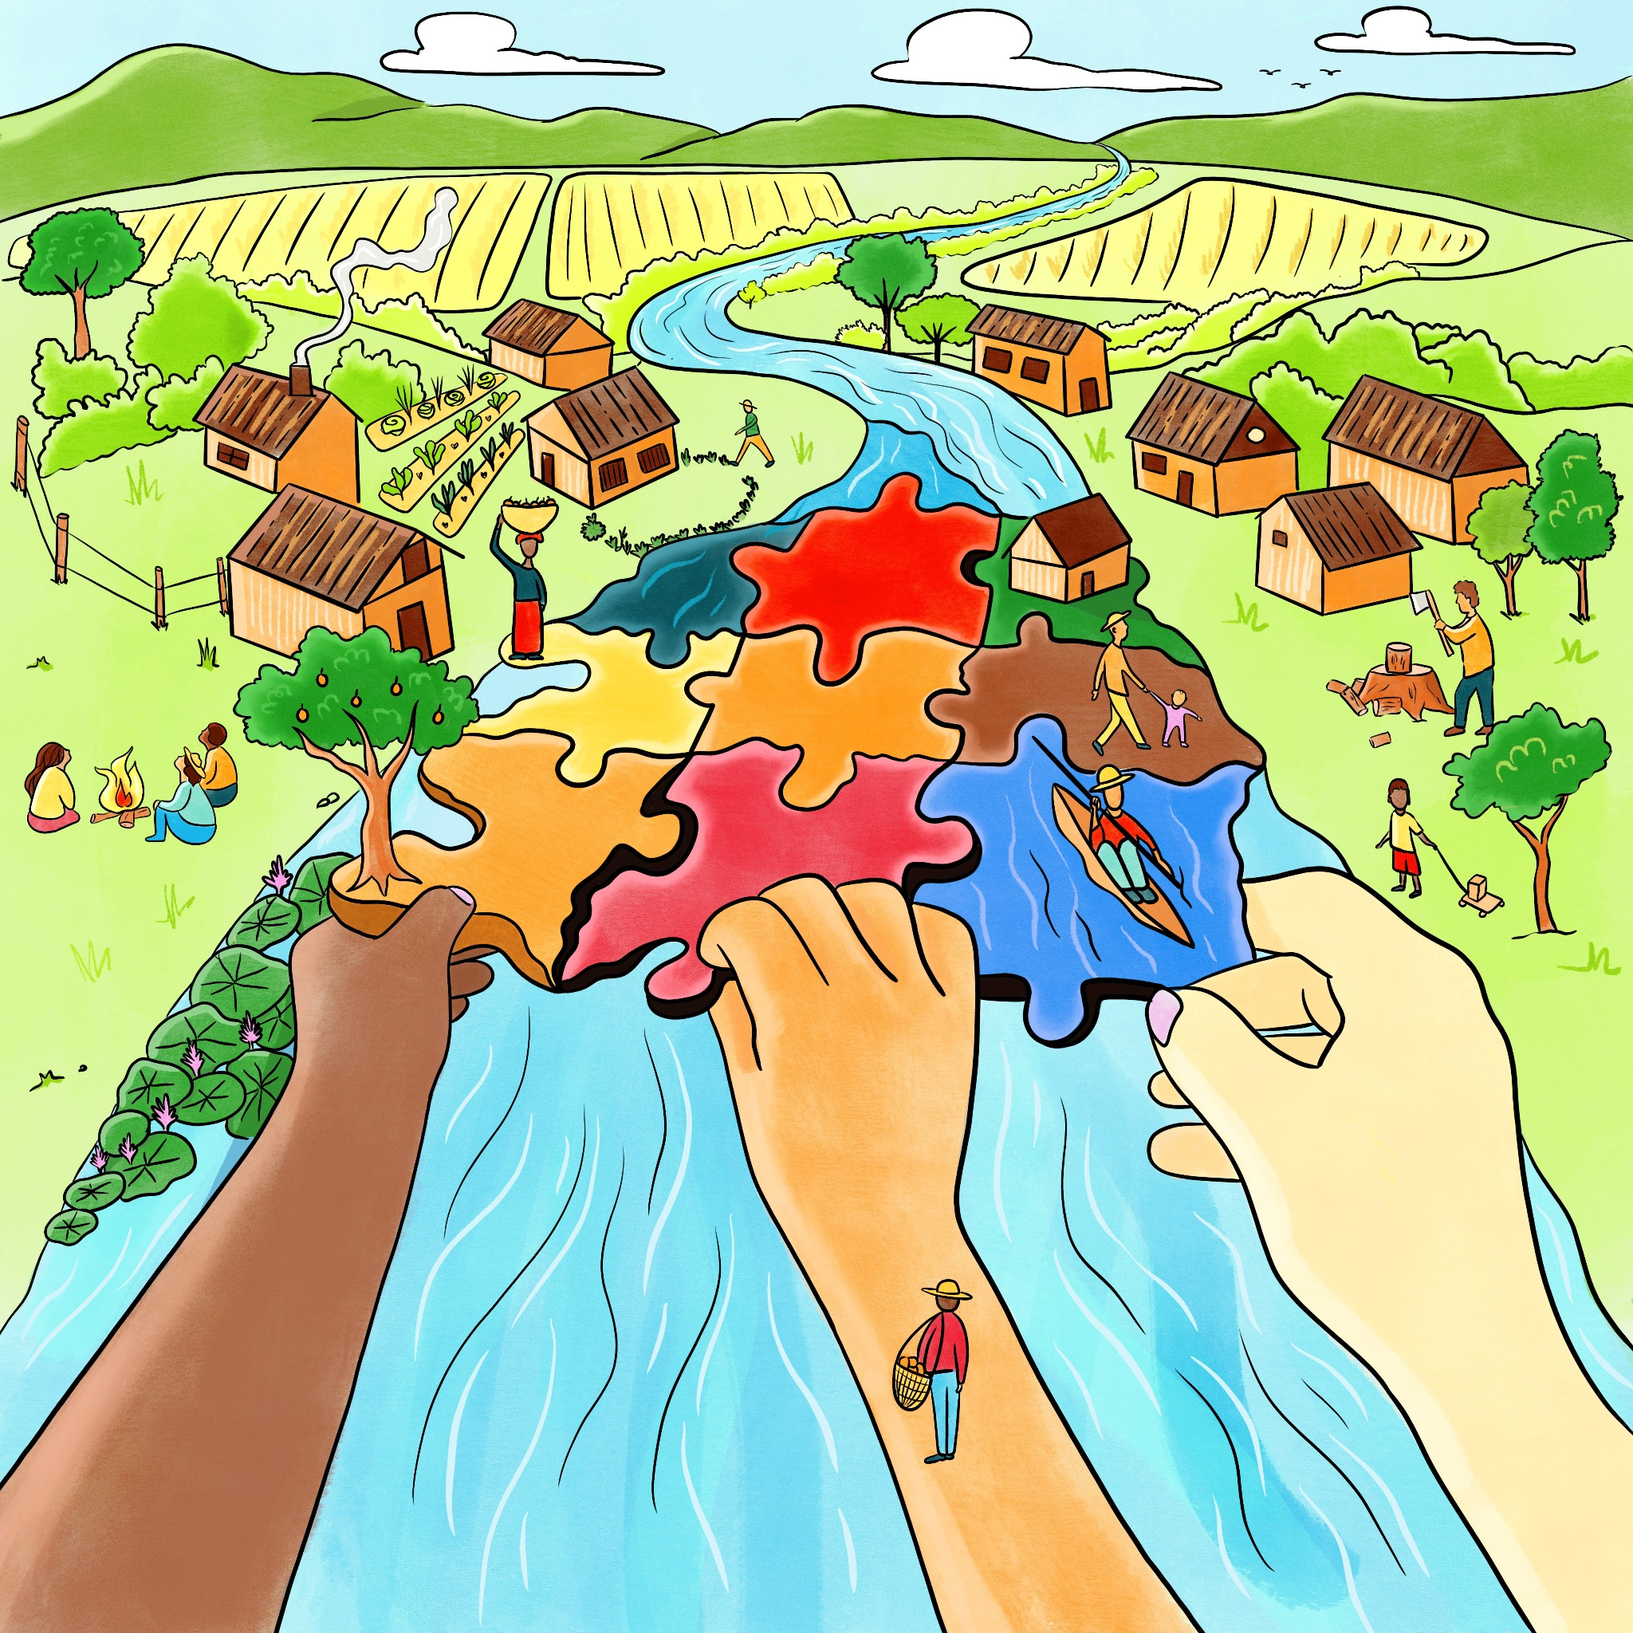
DEFINITION OF LANDSCAPE NARRATIVES
The collective and diverse stories, histories, and interpretations that define and give meaning to a specific landscape.

Slide 11
DISCUSS
Why are Landscape Narratives important to you and your landscape?
What do you want to learn more about today?
10 MIN

Slide 12
BREAK
15 MIN

Slide 13
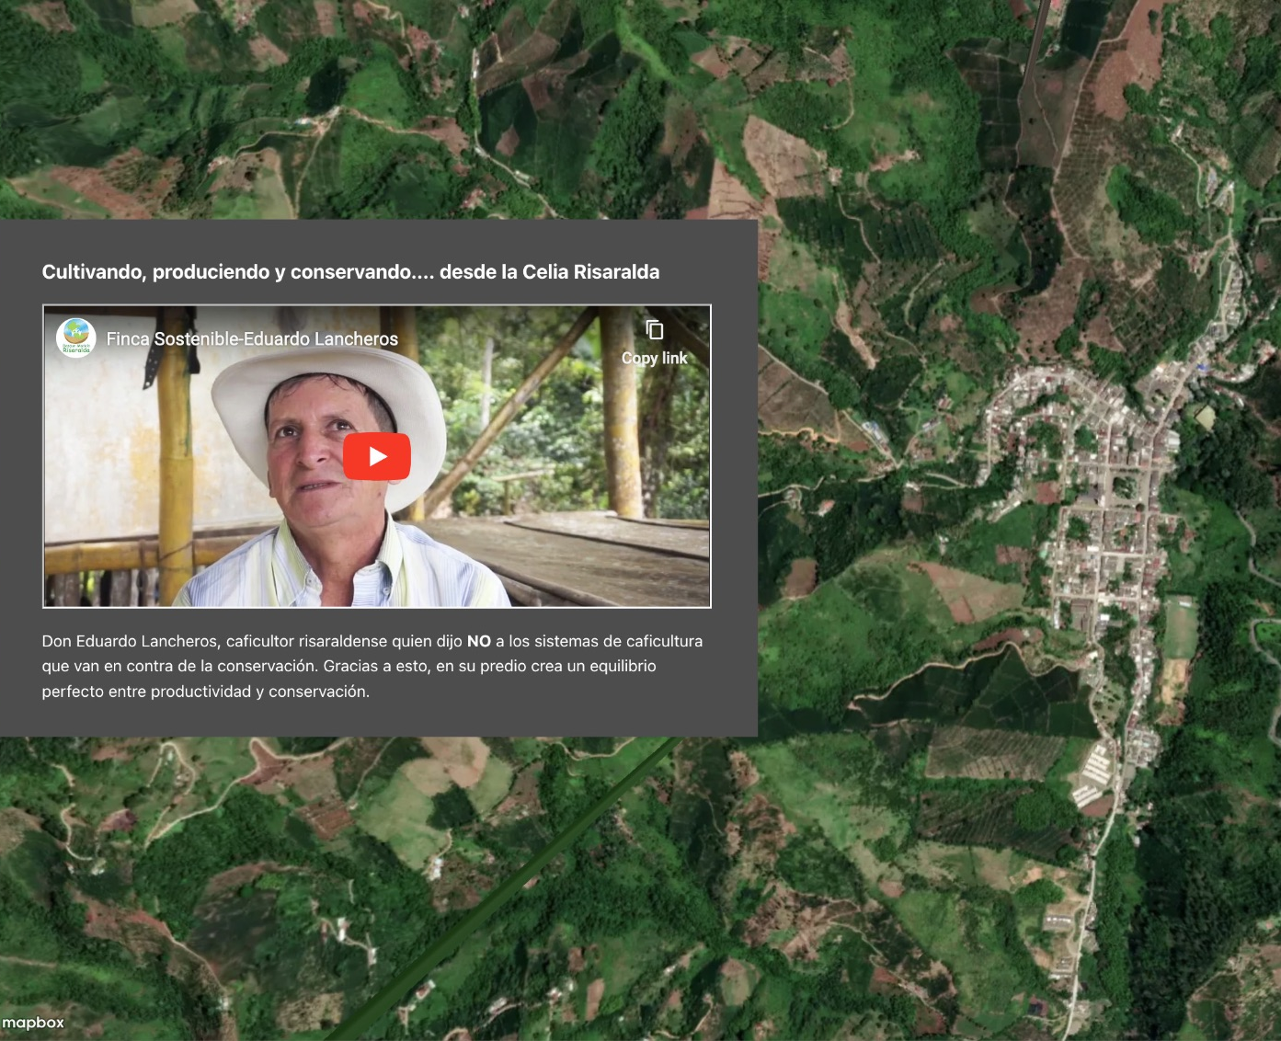
CASE STUDY RISALDA MODEL FOREST
StoryMap on Terraso
Digital maps let us mix places on a map with photos, videos, and stories.
Great for showing the where and what of a landscape, especially to those who love exploring online.
https://app.terraso.org/tools/story-maps/8099a35a/bosque-modelo-risaralda

Slide 14
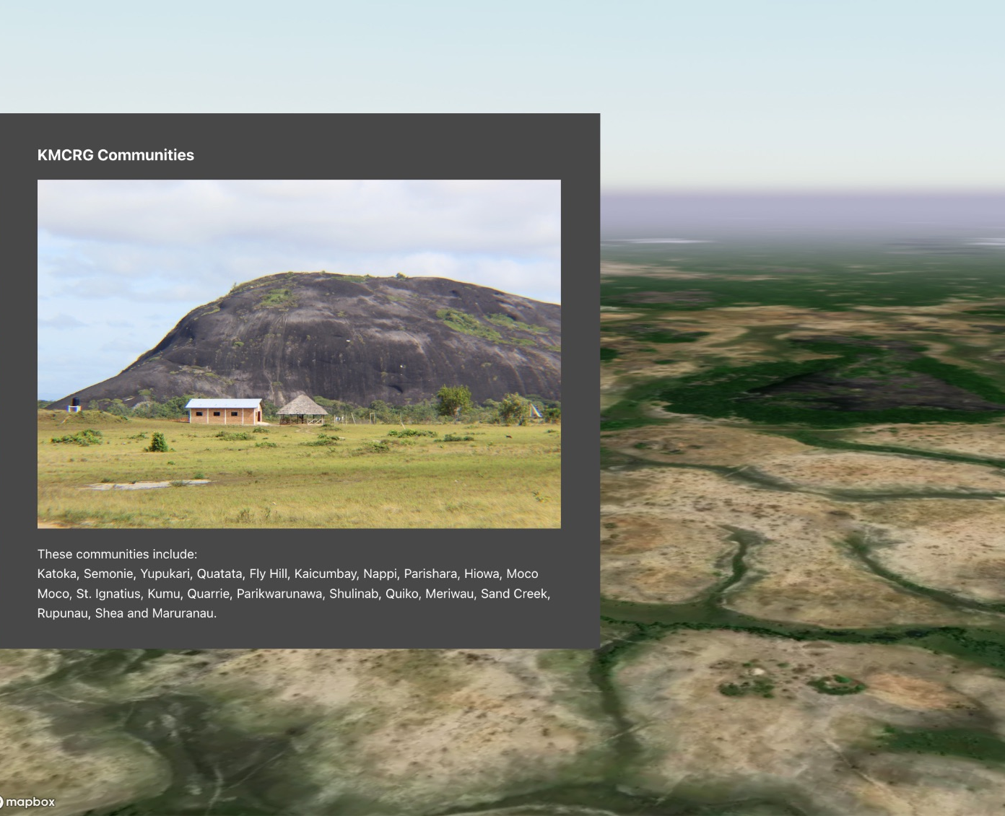
CASE STUDY KANUKU MOUNTAINS COMMUNITY
StoryMap on Terraso
Digital maps let us mix places on a map with photos, videos, and stories.
Great for showing the where and what of a landscape, especially to those who love exploring online.
https://app.terraso.org/tools/story-maps/35ed5e16/the-kanuku-mountains-community-representative-group

Slide 15
CASE STUDY WORLD WATER MAP
Digital Map
https://worldwatermap.nationalgeographic.org/

Slide 16
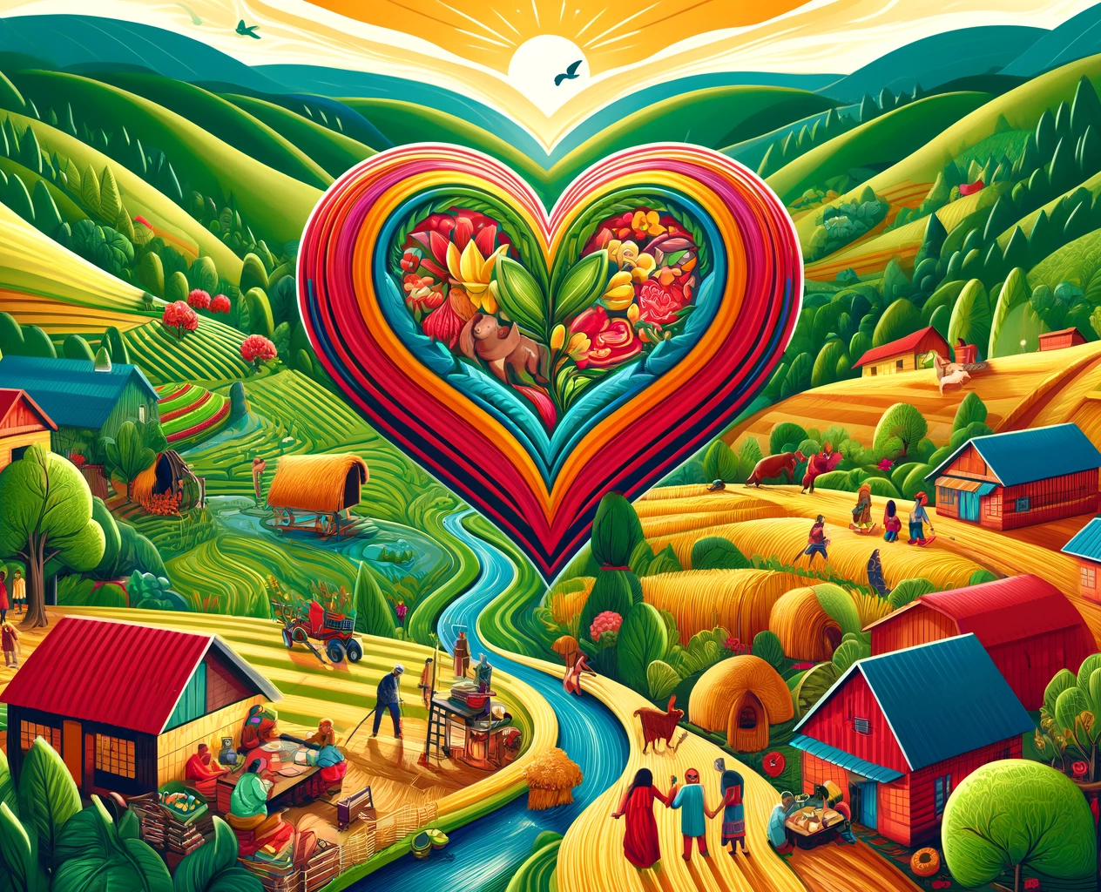
CASE STUDY SLILMALILA COMMUNITY
Stories about origins
Intergenerational storytelling
Inspiration for micro-watershed restoration in the community

Slide 17
SMALL GROUPS
What different kinds of landscape narratives have you encountered in your landscape?
Write them down.
10 MIN

Slide 18
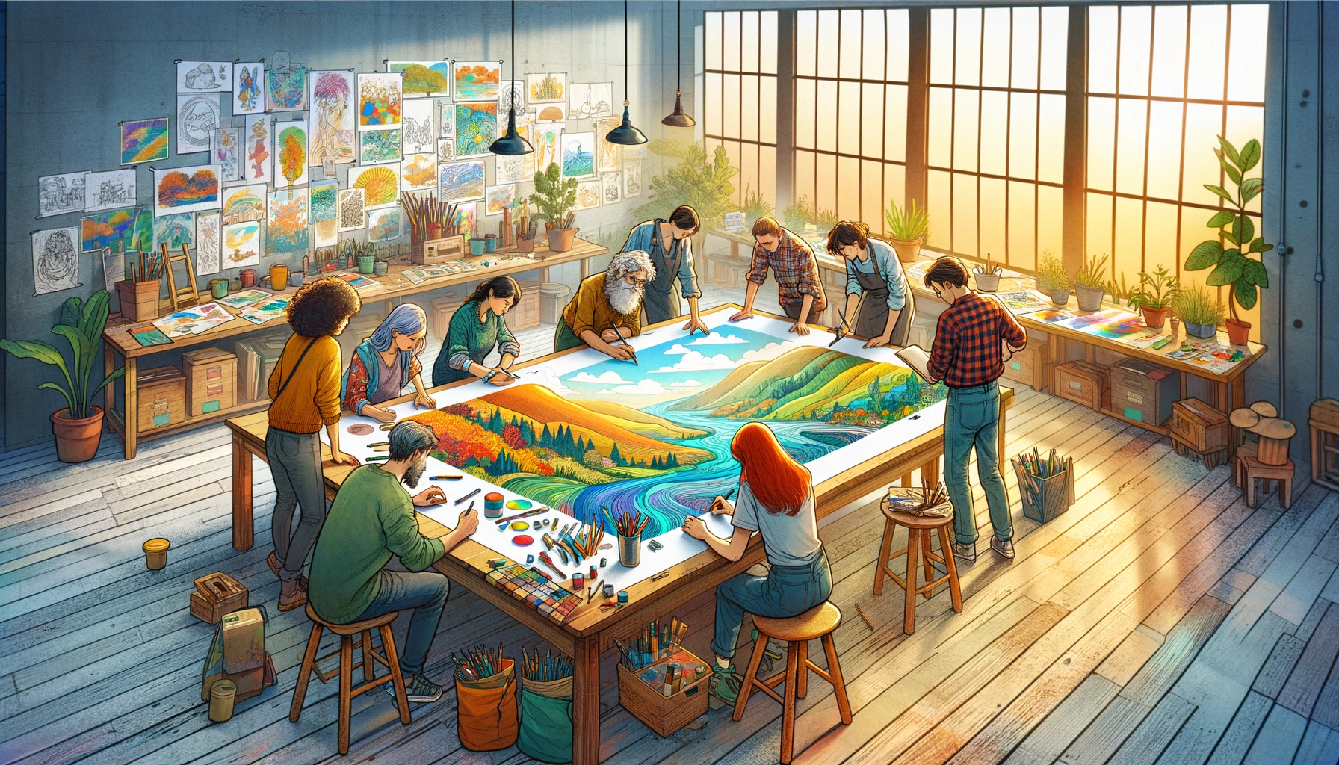
VISUALIZING A STORY

Slide 19
SMALL GROUPS
Draw your narrative as a story (Option 1)
Guiding questions:
How does the drawing tell a story about the land and its natural elements?
How does the drawing tell a story about the people?
Where do these stories come together?
20 MIN

Slide 20
Make a StoryMap on Terraso (Option 2)
Gather your digital story material: video, audio, images.
Log in to the StoryMaps app (https://app.terraso.org) and create your story map. Make it simple and short, no more than 5 steps in the story.
Online step-by-step guide: https://terraso.org/help/how-to-make-a-story-map/

Slide 21
LUNCH BREAK
40 MIN

Slide 22
ENERGIZER
X MIN
X MIN

Slide 23
CONNECTING WITH THE AUDIENCE

Slide 24
LANDSCAPE NARRATIVE FORMATS
Stories and storytelling
Museums and exhibitions
Documentaries and videos
Digital story maps
Social media posts
Infographics
Song, music and dance
Posters
Theatre
Planning documents and reports
Historical sites and landmarks

Slide 25
FINDING THE RIGHT FORMAT FOR THE RIGHT AUDIENCE
STAKEHOLDER (audience) | FORMAT | LANDSCAPE NARRATIVE
Project donor | Report | Community tree planting activities
Example

Slide 26
SMALL GROUPS
Finding the right format for the right audience
Recreate the table on 3 flipcharts, one per column.
Fill in for 5 key stakeholders
Share with other groups (presentation = 3 minutes)
20 MIN

Slide 27
SUCCESS FACTORS

Slide 28
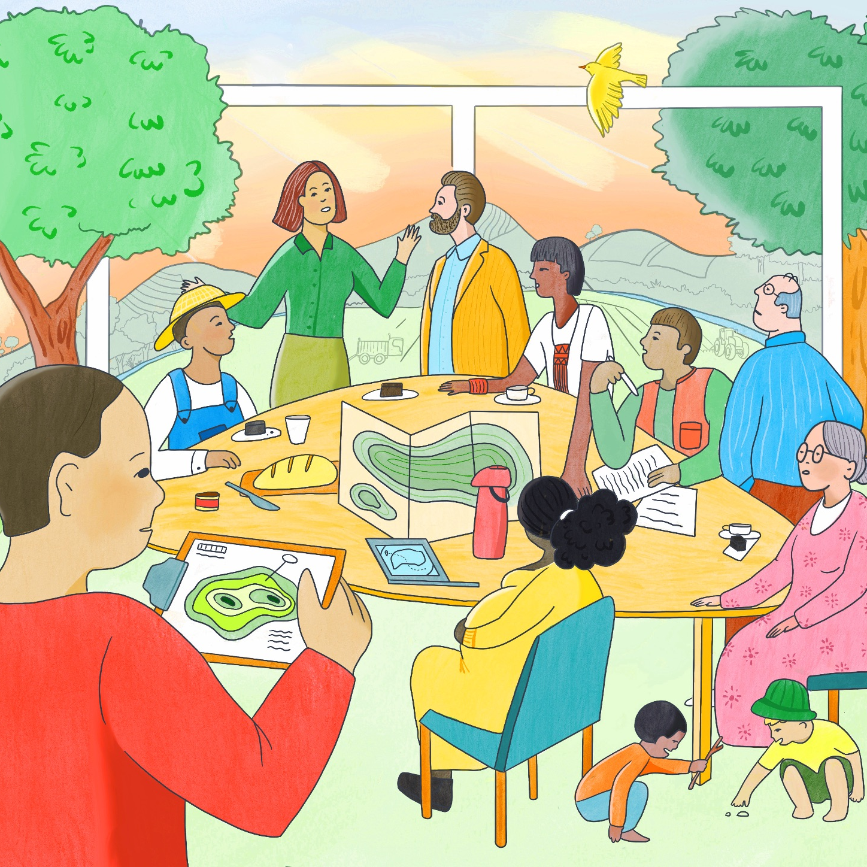
INCLUSIVE CO-CREATION
All voices heard
Diverse perspectives
Buy-in and support from stakeholders

Slide 29
STRATEGIC PLANNING & BUDGETING
Plan for success
Manage complexity
Mobilize resources

Slide 30
SMALL GROUPS
Choose one stakeholder-format-landscape narrative combination.
Make a plan to co-create a landscape narrative, include:
Which other stakeholders will be included, and how?
What phases does the process consist of?
What is the estimated budget, and how could you get this financed?
30 MIN

Slide 31
BREAK
15 MIN

Slide 32
Q & A

Slide 33
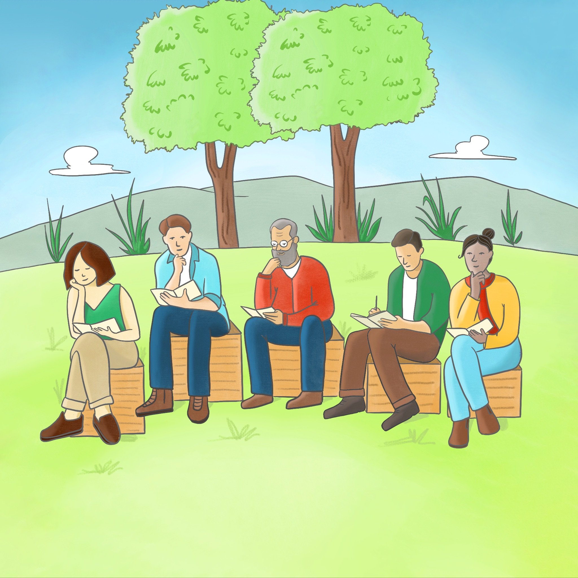
REFLECTION
What is your most important learning from today?
10 MIN

Slide 34
RECAP

Slide 35
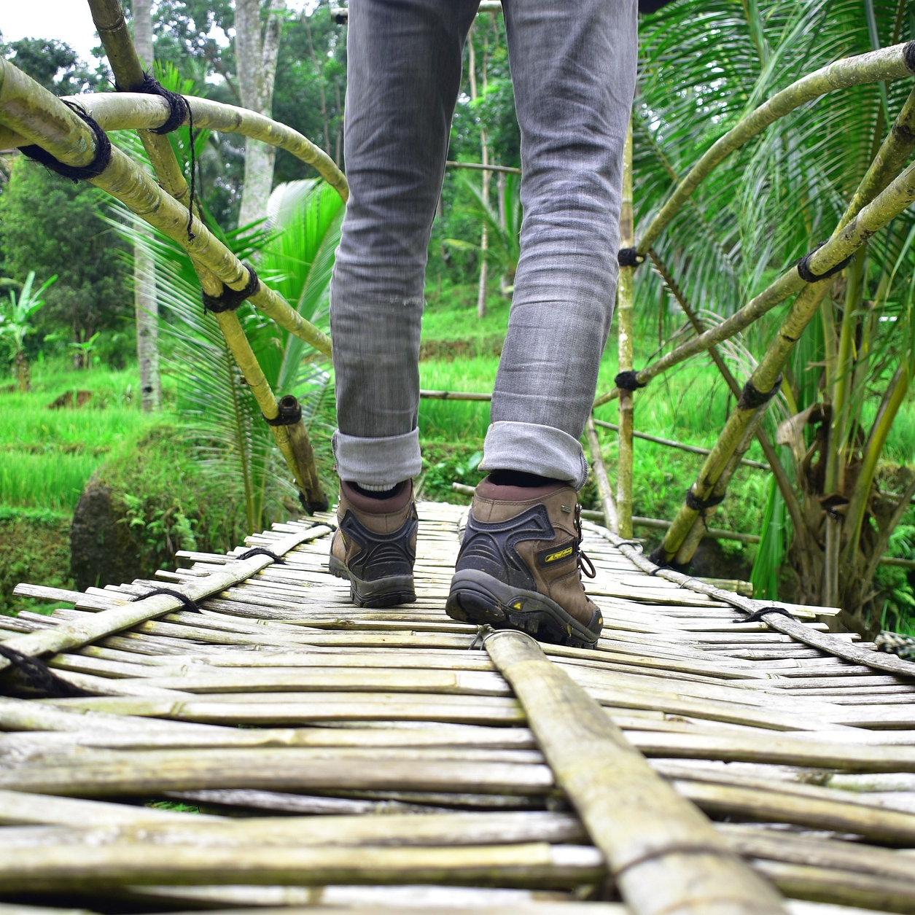
Facilitators:
Fill-in according to follow-up agreements made in your context
NEXT STEPS
Step 1
Step 2
Step 3
Step 4

Slide 36
Facilitators:
Fill in any recommended resources or readings
EXTRA RESOURCES
This is a title
Question / sentence
Question / sentence
Question / sentence

Slide 37
Facilitators:
Fill-in according to the feedback method used (see guide)
FEEDBACK
Question 1
Question 2
Question 3
Question 4

Slide 38
Replace names and emails of facilitators
MAX LEVY: mlevy@ecoagriculture.org
PATRICIA BON: pbon@ecoagriculture.org
Thank You!
Facilitators:
Replace names of facilitators and dates
LOGOS:
Add relevant logos
Patricia Bon, Max Levy, and Bemmy Granados. EcoAgriculture Partners
January 29, 2024

